Slide 1
HEART DISEASE PREDICTION
TSP- AI ML Fundamentals (Capstone Project)
Presented By:
A A Aadhithya – au810021214001
Guided By: Ramar Bose Sr. AI Master Trainer

Slide 2
OUTLINE
Problem Statement
Proposed System/Solution
Algorithm & Deployment
GitHub Link
Project Demo(photos / videos)
Conclusion
Future Scope
References

Slide 3
Problem Statement
The objective of this research is to assess the overall risk of heart disease through the application of Logistic Regression and Machine Learning techniques. As per the World Health Organization (WHO), approximately eighty percent of cardiovascular disease (CVD) fatalities are attributed to heart attacks. Recognizing individuals susceptible to CVD is pivotal for initiating preventive measures and providing timely treatments.

Slide 4
Proposed Solution
The Logistic Regression model provided in Google Colab for Heart Disease Prediction encompasses data preprocessing, feature selection, and model building stages. Leveraging this Logistic Regression model for myocardial infarction (MI), it becomes feasible to evaluate an individual's likelihood of developing cardiovascular disease. Such a model offers healthcare professionals the means to pinpoint high-risk individuals, enabling them to deploy tailored treatments and lifestyle interventions aimed at mitigating the adverse outcomes associated with cardiovascular disease.

Slide 5
Algorithm & Deployment
Data Preprocessing: The dataset undergoes preprocessing steps such as handling missing values, encoding categorical variables, and scaling numerical features.
Feature Selection: Relevant features are selected based on their significance in predicting CVD risk, using techniques such as correlation analysis and feature importance ranking.
Model Development: A Logistic Regression model is trained using the preprocessed dataset. The model learns to classify individuals into two classes: those at risk of developing CVD and those not at risk.

Slide 6
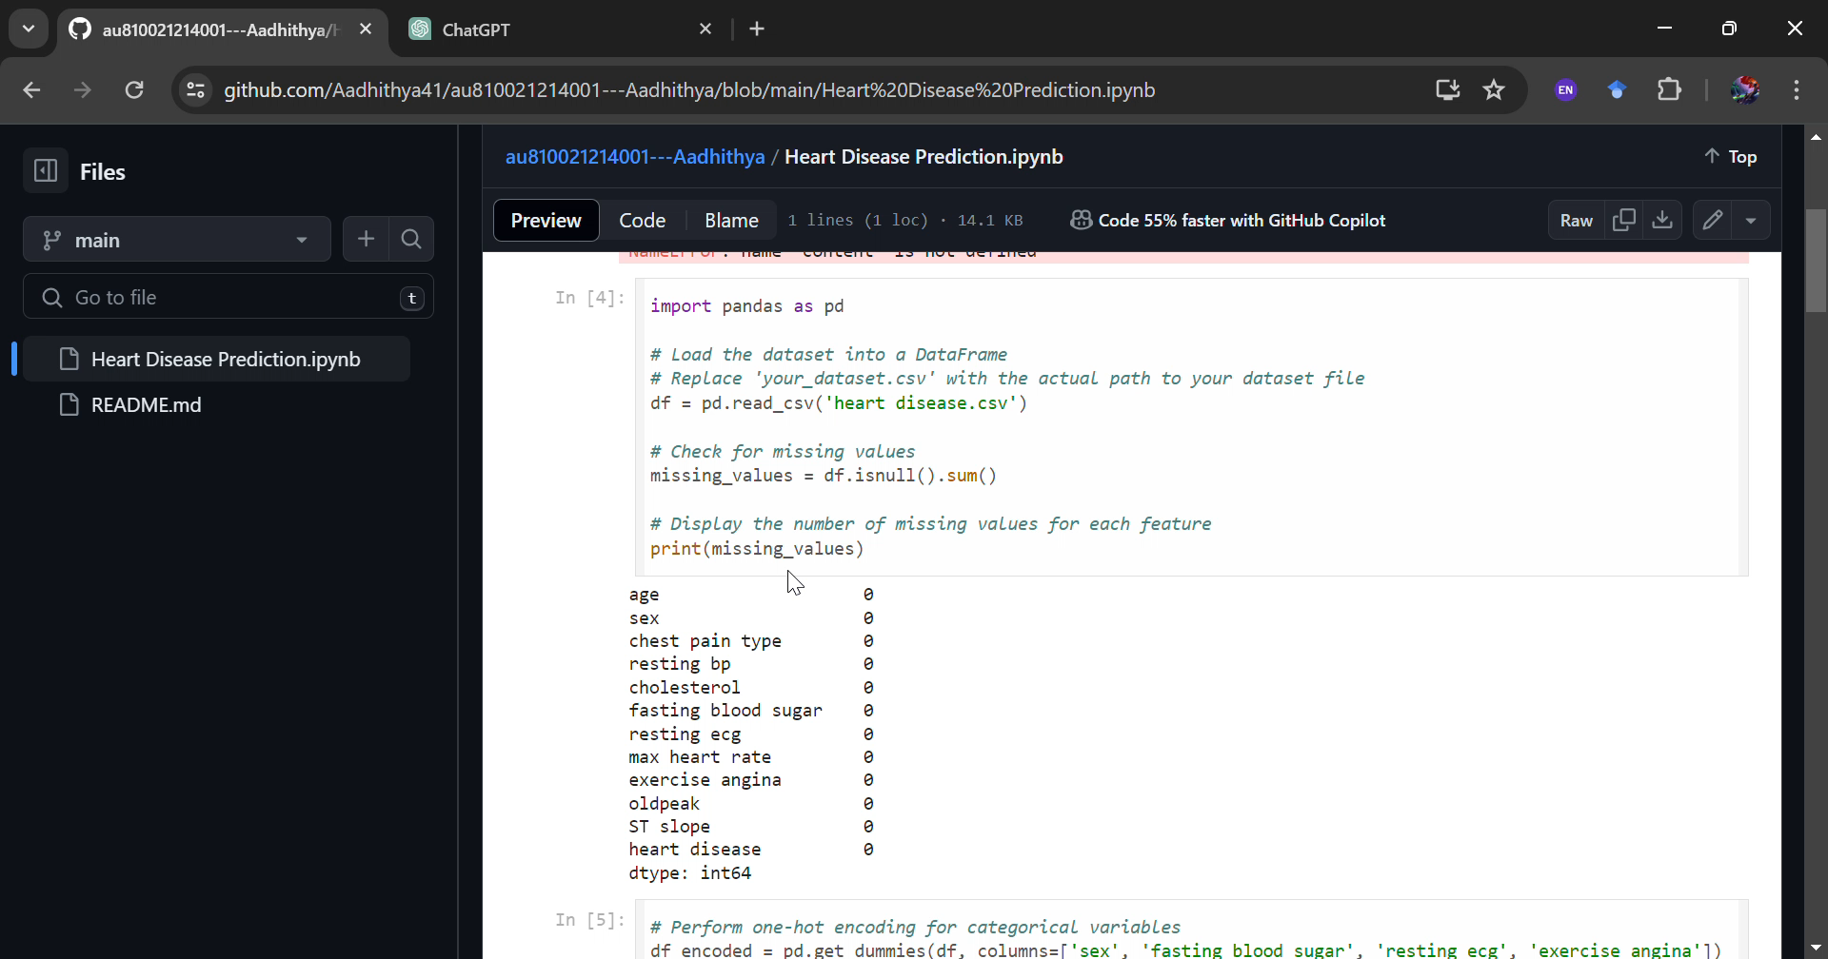
Project Demo(Recorded Video)

Slide 7
GitHub Link
https://github.com/Aadhithya41/au810021214001---Aadhithya.git

Slide 8
Conclusion
Utilizing Logistic Regression for forecasting the risk of heart disease offers valuable insights into discerning individuals predisposed to cardiovascular disease (CVD), potentially averting adverse health consequences. Logistic Regression effectively models the likelihood of CVD occurrence, incorporating various risk factors, thus facilitating timely interventions and targeted healthcare strategies. These results underscore the significance of proactive healthcare measures, including lifestyle modifications, routine screenings, and personalized treatments, in mitigating CVD risk factors and enhancing patient outcomes.

Slide 9
Future Scope
The outlook for heart disease prediction using Logistic Regression appears optimistic. By integrating additional risk factors and advanced machine learning methods, there is potential for the creation of more sophisticated prediction models, enhancing accuracy and dependability in identifying individuals susceptible to cardiovascular disease (CVD). Moreover, the evolution of personalized medicine is expected to revolutionize the management of heart disease, offering tailored interventions and treatments to optimize patient care.

Slide 10
References
Project Github link, Ramar Bose , 2024
Project video recorded link (youtube/github), Ramar Bose , 2024
Project PPT & Report github link, Ramar Bose , 2024

Slide 11
THANK YOU

